Slide 1
Adding Lists and Libraries to Sites

Slide 2
Agenda
Define Purpose and Create Lists and Libraries
Site Columns and Content Types
Design and Manage Workflows in SPD2010
Design Views and Configure List Web Parts
Manage List and Item Permissions
Taxonomies & Metadata

Slide 3
The Purpose of Lists and Libraries
Core container of SharePoint
Store user supplied content
Store site definition items
Store site settings and configuration
Libraries and galleries
Notes:
Lists are the core container object in SharePoint and are used to house everything from configuration values and templates to user items and files. Almost EVERYTHING saved into SharePoint is stored in a list!
Lists define their items by metadata values that, when combined, make up the item itself. Metadata is just a fancy term for data that describes other data. In a list, the item metadata is kept in columns (sometimes referred to as fields) and each row of column values comprises an item. Lists themselves also have metadata, such as the list’s name, description and other values that describe the list itself and make it unique within the site. Sometimes we refer to the list metadata as properties or attributes of the list.
Libraries are super-lists that store not only metadata about their items but an actual file to comprise the item as well. Unlike libraries, simple lists can only provide an attachment pointer to an actual file. But libraries house the file itself as a row item and build additional metadata around the file according to the columns defined in the library.
Galleries are system libraries specifically designed to house files and items that are used to construct and define SharePoint. There are several galleries (such as Site Columns, Site Content Types, Web Parts, List Templates and more) in any given site template. These galleries are accessible only by site administrators and site collection administrators via Site Settings.

Slide 4
A Few Criteria for Creating New Lists
Intended items do not fit into a data taxonomy classification currently being served by another list
Intended items need a different set of metadata than the columns defined in any of the existing lists
Intended items require different workflows than those defined on existing lists AND there is a large enough volume of intended items to discourage item-level or content type level workflow associations.
Notes:
Before you jump in and create a new list or library a fair degree of planning would be prudent. Some SharePoint enterprises even require change control measures that justify the new list before adding the overhead of another container object to a SharePoint site. Some common questions you should ask yourself before creating a new list include:
What kind of items are going to be created?
Do those kinds of items match a defined data taxonomy class in our information architecture?
Is that defined data taxonomy class not currently being served by an existing list?
Would the intended items (classified or not) be satisfied by the column mix of an already existing list?
If the intended items were to be stored in an existing list, would they require different security permissions than those already in effect on the existing list? And if so, is disabling inheritance on a folder or item allowed in our SharePoint enterprise?
Do the intended items need a workflow to enforce business rules about them and to automate business processes for them? And if so, are those workflows already in place on an existing list?

Slide 5
Tips for Creating Lists and Libraries
Each list template bears a unique mix of columns and a prescribed selection of content types.
Name = URL so define a URL-friendly name (i.e. concise with no spaces)
Organize items into folders if necessary
Consider site columns before creating a new list-centric column
Associate multiple content types with the list if you need to store multiple item or file types
Notes:
Plan new lists and libraries carefully before creating them. First and foremost select an appropriate list template, preferably one that already includes most of the columns you will need to define your items’ metadata. Be aware that once a list has been created, it is very time-consuming to change its template. The list template includes system information about the list that influences the list’s behavior.
Secondly, when creating a new list the value you enter for the Name of the list will become the list’s URL as well. And while human users prefer that a name consisting of multiple words contain embedded spaces, URL’s with embedded spaces resolve into ugly text strings with UTF-16 placement holder text in place of those spaces (%20). Consider initially naming your list with no spaces then editing the Title property of the list once it’s up and running to include the pretty embedded spaces.
Third, plan how to best organize lists that will house large volumes of multiple classes of items into folders (and perhaps folders within those folders). CAUTION: do not go too deep with folder nesting or users may find it difficult to locate their desired items, negatively impacting productivity.

Slide 6
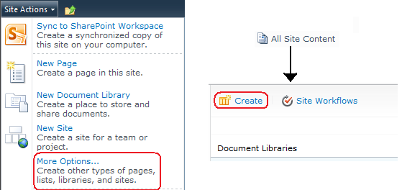
How to Create a List or Library
Notes:
The web browser interface of a SharePoint site usually provides more than one avenue to accomplish a goal and creating lists is no exception. You can either select the More Options… hyperlink from the Site Actions menu or engage the Create toolbar button in the All Site Content page. Of course, to see either of these options in a security trimmed interface, you must be logged onto the site as a user who has been granted the Manage Lists permission on the site.
SharePoint offers several list and library templates to assist you in creating a new list. The templates available on any given site will be dictated by the SharePoint Features that have been activated for that site on all four Feature scope levels. For example, a Pages library template is only available if the SharePoint Server Publishing Feature is active. And while there is a blank Custom List template to create a bare bones list that you will then configure with columns of your choosing, there is no similar blank library template. When creating a highly custom library, select a template that most closely resembles the content type associations, columns and default document template you wish for your new library then strip unwanted columns and create new columns after the library is created.
List and library settings including content approval, versioning, force check-out, content type management and more can be customized after the list is created. Microsoft recommends setting these configuration properties as soon after creation but before item additions as possible to ensure early items into the list are properly managed according to business rules.

Slide 7
A Bit About Columns
Each column is restricted to a specific data type
The column type dictates configuration settings
Any column can be set to Require a value
Some column types can store multiple values
Changing a column type after creation is limited
Notes:
SharePoint offers the following types of columns:

Slide 8
DEMO
Lists, Document Libraries & Forms Libraries
Notes:
In this demonstration, your instructor will illustrate:
How to create a custom list and define custom columns
How to create a document library
How to create a forms library

Slide 9
Agenda
Define Purpose and Create Lists and Libraries
Site Columns and Content Types
Design and Manage Workflows in SPD2010
Design Views and Configure List Web Parts
Manage List and Item Permissions
Taxonomies & Metadata

Slide 10
Site Columns and Content Types
SITE COLUMNS
SITE CONTENT TYPES
Re-useable column definitions stored in a site level gallery
Can be associated with multiple lists
Form a dependency
Enforce metadata consistency
Re-useable content definitions stored in a site level gallery
Can be associated with multiple lists
Form a dependency
Enforce metadata, default template, workflow, and policy consistency
Notes:
Site columns and site content types are SharePoint objects often used to enforce consistency and reduce administrative overhead.
Site columns are column definitions without a home. They are stored in a site level gallery and are redistributable to multiple lists, libraries and content types. When you employ a site column on a list, library or content type, a new column will be created on that object that is linked back to the site column definition stored in the Site Column gallery. As such, the new column on your object will have the same column name, type, restrictions and property values as the site column from which it is derived…at least initially. While list designers have the ability to change some properties columns on their lists, doing so on a column derived from a site column is NOT recommended. Why? Because the site administrator could decide to alter the site column’s definition and select the option to force their change down to all list and library columns derived from that site column, thereby overwriting the List designer’s customizations to the column on their list. Some of these changes may corrupt the data values already stored in the column.
Site content types are item definitions without a body, they are stored in a site content type gallery and are redistributable to multiple lists and libraries. Content types define aspects of a list item before the list item even exists. For example, a content type for future documents may define the metadata that will be maintained about the document (site columns), the default document template that will be used to create the new document (i.e. Microsoft Word), the workflows required for such new documents, and even Information Management Policies that will be used to protect or mark the new document. By associating such a content type with a particular document library, you give users the opportunity to create new items into the library that meet certain business rules without them needing to be aware of said business rules. New site content types created by site administrators must be based on an existing site content type (system supplied or custom), creating a dependency chain. Changes made to the parent content type can be forced down to all content types derived from that parent content type, thereby overwriting any customizations that had been made to the child content type.

Slide 11
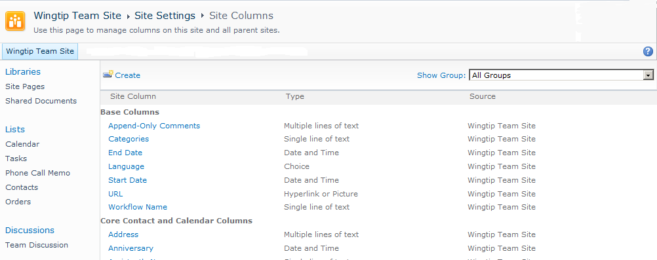
The Site Columns Gallery
Site Columns Gallery of a Top Level Site
Notes:
Every site in SharePoint has a Site Columns gallery by default. Child sites in a site collection hierarchy will inherit the site column items of their parent site’s Site Columns gallery and offer them in their own galleries, albeit in an non-editable fashion, right beside any custom site columns created in that child site. This means that site administrators of the child sites can take advantage of associating site columns from a gallery higher up in the site collection to their lists and libraries…they just cannot modify the definition of said site column. Only site administrators of the site containing the gallery in which a custom site column was created can modify said site column (and site collection administrators as well since they have full control to every site in the collection).
Site Column Galleries organize their site column items into Group headings (these are NOT folders) to make it easier for administrators and list designers to find the best site column for their lists. When a site administrator creates a new site column there is an option to place the new item under an existing group heading or create a new group heading. In this manner, custom group headings can be added to the gallery.
Site Column Galleries are a superset of lists and thus behave differently. For instance, the items in the gallery do not have selection checkboxes or contextual drop-down menus. There are no Items or List ribbons and no List Settings to modify the structure of the gallery. Modifying a gallery’s structure can be accomplished in SharePoint Designer 2010 or Visual Studio 2010 but this practice is ill-advised because a future critical patch or service pack from Microsoft may alter the gallery and overwrite your custom settings.

Slide 12
Creating a Custom Site Column
Requires the Manage Lists permission
Exhaust all existing site columns as potential solutions before creating additional site columns
Create site columns in the highest site’s gallery possible to make them more available throughout the site collection hierarchy
Column properties are the same as list-centric columns
Notes:
Creating new site columns can only be accomplished by users with elevated privileges to the site. It requires the Manage Lists permission, an authority usually reserved for designers, hierarchy managers and site administrators.
Before embarking on site column creation, be sure you efforts are not unwarranted by perusing the existing site columns to determine if one of them will work for your purpose. Be sure to consider not only the site columns created in and managed by your own site’s Site Columns gallery but also those inherited from parent sites’ galleries going up the site collection hierarchy.
If indeed you determine that a new custom site column is necessary, defining the site column is little different than defining list-centric columns. You must give the column a name that is unique within its gallery, select a column type and configure the settings pursuant to that column type. However, there is one property you must define on site columns that is not on list-centric columns: the site column gallery group heading.

Slide 13
DEMO
Site Columns
Notes:
In this demonstration, your instructor will illustrate:
How to create custom site columns.
How to add site columns to a list.

Slide 14
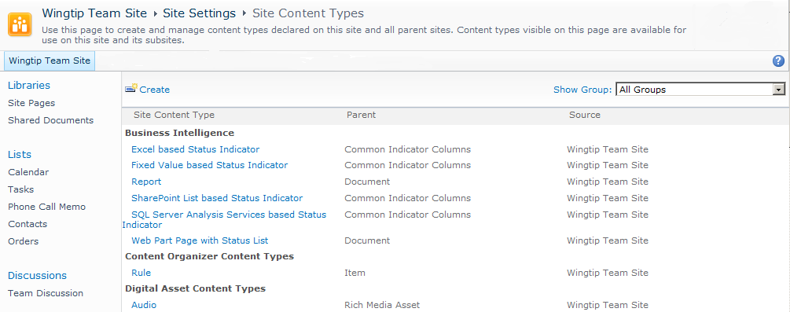
The Site Content Types Gallery
Site Content Types Gallery of a Top Level Site
Notes:
Like Site Columns galleries, every site in SharePoint has a Site Content Types gallery by default and child sites in a site collection hierarchy will inherit the site content types of their parents in read-only fashion. Site administrators of the child sites can employ the inherited content types on their own lists or create additional custom site content types to be used on their own site and its subsites.
Also like Site Column galleries, Site Content Types galleries organize their items into Group headings. When a site administrator creates a new site content type there is an option to place the new item under an existing group heading or create a new group heading. And the Site Content Types gallery offers no item selection checkboxes, item contextual drop-down menus or list ribbons.
However unlike site columns, site content types are hierarchical in their own right. A custom content type created in the browser by a site administrator must be based upon one of the existing site content type items already appearing in the gallery. The parent can be either a system-supplied content type or a fellow custom content type and may be resident in this gallery or inherited into this gallery from a parent site.

Slide 15
Creating Custom Site Content Types
Requires the Manage Lists permission
Consider existing site content types before creating a new one
Beware deep dependency chains (performance)
Create site content types in the highest site’s gallery possible
Define content type’s metadata first then define its configuration (columns, workflows, etc.)
Notes:
Like site columns, creating new site content types is a task usually deferred to site administrators or other users with highly elevated privileges on the site. However unlike site columns, the creator of a site content type must proficient at more than just column design. They must also be well versed in default templates, workflows and information management policies.
Site content type creators should avoid creating undue objects or building content types that depend on content types that depend on content types creating a deep dependency chain. SharePoint’s performance may degrade when resolving such deep dependency chains.
If a new custom site content type is indeed warranted, try to build it in the site content type gallery that is in the highest site possible in the site collection hierarchy. This will ensure that the new site content type is available in as many child sites as possible. When you first create the new content type object, you will define its name and set its metadata (such a Creation date and Created by) first then proceed to configuring its functionality (columns, workflows, information management policies, and more). Each content type must be uniquely named within its gallery.

Slide 16
DEMO
Content Types
Notes:
In this demonstration, your instructor will illustrate:
How to create custom site content types.
How to add site content types to a list.

Slide 17
Agenda
Define Purpose and Create Lists and Libraries
Site Columns and Content Types
Design and Manage Workflows in SPD2010
Design Views and Configure List Web Parts
Manage List and Item Permissions
Taxonomies & Metadata

Slide 18
Design and Manage Workflows in SPD2010
Multiple workflow scopes
Wide range of workflow step conditions & actions
Supports variables
Impersonation
Visio 2010 integration
CAVEAT: SharePoint Designer 2010 is a sophisticated SharePoint editing application that necessitates its own education offerings. This course will only briefly examine one aspect of the software: workflows.
Notes:
In SharePoint, information workers can create simple workflows right in the browser using predefined workflow templates to guide them. But these templates are very limited and often customization beyond the template’s properties is needed. More sophisticated workflows can be created in SharePoint Designer 2010 (SPD2010) by site administrators, then associated with container that will benefit from the workflow processes. But even the wizards in SharePoint Designer 2010 have their limits, so if a SharePoint enterprise demands highly complex workflows, Visual Studio 2010 programmers must get involved to write C#.NET or VB.NET code against the SharePoint Object Model.
Disclaimer: In this course, we will take a brief look at creating and managing workflows in SharePoint Designer 2010. But keep in mind that SharePoint Designer 2010 is a very intricate application that warrants its own training courses and cannot possibly be condensed into this one lesson of one module. Therefore a certain degree of knowledge is assumed in the following discussion.
SharePoint Designer 2010 provides several possible scopes for workflows (site collection, site, list, item, content type or TBD). The scope is either determined prior to workflow creation by choosing the appropriate workflow type to create (List vs. Reusable vs. Site) or during workflow creation by publishing the workflow to the global workflows catalog (site collection wide availability). Workflows created in SharePoint Designer 2010 support variables for dynamic values to be added a runtime as well as impersonation for running the workflow processes under a security context other than the logged on user who’s actions instigated the workflow. Also, SharePoint Designer 2010 integrates with Office Visio 2010 to provide graphically visual workflow depictions. In fact, you can even design your workflow visually in Visio 2010 then import it into SharePoint Designer 2010 to create the actual workflow routine!

Slide 19
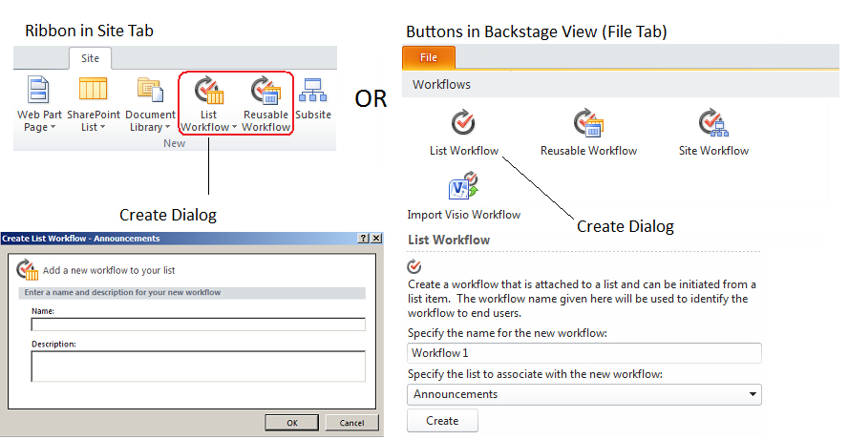
Creating Workflows in SPD2010
Notes:
Like other Office 2010 applications, SharePoint Designer 2010 has a new user interface. SPD2010’s interface is divided into the Site View (Site tab) and the Backstage View (File tab). You can begin creation of a new workflow from either of these views, as depicted in the illustration above. However each method of kicking off your workflow creation leads to slightly different dialog boxes in which to enter the new workflow’s identifying metadata.
Workflows consist of a series of Steps, each of which bears one or more Conditions that must be met in order for the step’s Actions to take place. SPD2010 provides a limited set of Conditions to choose from for your steps and a limited set of Actions to configure for your steps. Still, there is more design flexibility in SPD2010 than when creating a workflow from a predefined template in the browser. In fact, during workflow design the ribbon at the top of the page in SPD2010 becomes a Workflow ribbon, providing buttons for adding steps, conditions, actions, and even initiation form parameters and local variables for the workflow steps!

Slide 20
Managing Workflows in SPD2010
Offline editing with Publish feature
Debugging (Error-Checking)
Export to Visio 2010
Rename or Delete
View History
Notes:
SharePoint Designer 2010 is also a very robust tool for monitoring and managing your SharePoint workflows. When editing existing workflows, you can work offline then publish your edits back to the SharePoint server in one operation to avoid corrupting instances of the workflow that are currently running or to alleviate the need to disable the workflow from running at all while you perform your editing work.
There is also a Check for Errors button in the Workflow ribbon that will peruse your workflow steps looking for syntax or grave errors. And you can easily export your workflow to Visio 2010 for quick documentation of its processes. Renaming, re-associating or deleting workflows can be performed from the Edit and the Manage sections of the Workflow ribbon. And you can view the general settings and run history of the workflow in one convenient window pane.

Slide 21
DEMO
Creating & Customizing Workflows
Notes:
In this demonstration, your instructor will illustrate creating and managing a workflow in SharePoint Designer 2010.

Slide 22
Agenda
Define Purpose and Create Lists and Libraries
Site Columns and Content Types
Design and Manage Workflows in SPD2010
Design Views and Configure List Web Parts
Manage List and Item Permissions
Taxonomies & Metadata

Slide 23
Advantages of Views
Alter the display of a list
Public vs. Private
Can be filtered, sorted and grouped
Calculate and display totals for numeric columns
Can be mobile enabled
Constitute a configuration setting range for the list’ web part
Can be audience targeted via list’s web part
Notes:
Views are powerful tools that allow you to alter the metadata being displayed about SharePoint items without having to define a completely separate lists. Because list views can filter the columns being displayed, they allow for the consolidation of vast lists that incorporate the disparate metadata (columns) of large numbers of un-related items.
View designs that may prove useful to multiple users can be created as Public views. These views appear in the Current View drop-down menu for anyone with Read permissions to the list. Private views, on the other hand, are appropriate when a single user needs a highly customized view of the list. A private view will only appear int he Current View drop-down menu for its creator under a category heading entitled Private.
Views offer item control beyond the default AllItems view created with most list templates. Specifically, items can be filtered so that only items meeting specified criteria appear in the view. Also, items can be sorted and grouped and even have selection checkboxes or edit buttons added to them. A view can be mobile enabled so that SharePoint trims off the extra formatting and chrome when the view is requested by a mobile device.
But perhaps most importantly, view choice is one of the fundamental configuration settings of a list’s web part when it gets added to a web page. By default, whichever public view bears the “Make this view the default view” check mark will be the view displayed by the list’s web part. However this configuration setting on the web part can be changed to any one of the public views that exists on the list. By customizing this web part setting and invoking audience targeting on the web part (both concepts were covered in an earlier module of this course) you can make sure that the appropriate view of a list gets displayed for specific users.
One limitation of views is that they are a product of a single library and can only contain items from that library. However users who need to work with and manage a set of documents as a unit even though the documents are stored in separate libraries can take advantage of the SharePoint 2010 document set content type!

Slide 24
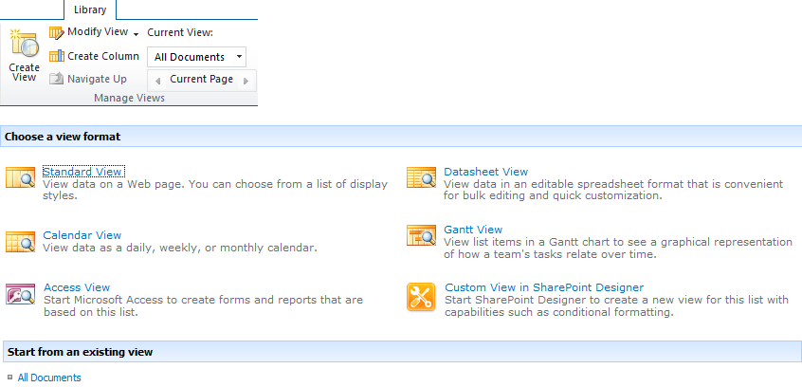
Creating Views
Notes:
Creating a custom view of a SharePoint list or library gives you the opportunity to define:
View Format:Standard, Datasheet, Calendar, Gantt, Access, Custom (SPD2010), or copy an existing view and modify it
View Name:doubles as the page name in the URL too so be concise and try to avoid embedded spaces
Default status:specify whether the view will be the default view of the list
Audience:specify whether the view will be available to all users (public) or only the view creator (private)
Columns:which columns from the list will appear in the view
Sort:select a column to sort the items by and the order (ascending or descending)
Filter:specify whether to include all items or only those items that meet one or more configurable filter criteria
Inline Edit:enable or disable edit buttons appearing on each row item
Tabular View:specify whether selection checkboxes will appear on each row item
Group By:select which column’s values to group the rows by
Style:format the row grid
Folders:enable or disable folder display (all items appear together despite folder location if disabled)
Item Limit:set the maximum number of items that will appear in the view
Mobile Access: specify whether the view will be enabled for mobile access and if so, if it will be the default mobile view and the item limit

Slide 25
List Web Parts
Every list has its own web part
List web parts can be configured to display up to one of the list’s public views at a time
There is no view choice interface in a list web part display
Editing web parts requires elevated privileges on the page
Notes:
Web parts, as was covered earlier in this course, are an ASP.NET concept and therefore available in SharePoint 2010. While there are many kinds of web parts that perform many kinds of functionality, in this lesson we are going to focus on list web parts.
When a list or library gets created in a SharePoint site, either during site creation according to the site template or by a site administrator later, the list or library gets a unique web part created as well. The web parts of all lists and libraries on the site are displayed under a category entitled List and Libraries when adding web parts to a web page, but in reality the web part gallery does not organize its items under any type of group headings.
Each list web part has a single-value configuration property called Selected View that dictates which of the public views created for the list will appear in the web part. When adding a particular list’s web part to multiple pages, each web part on each page can be configured to display a different public view of the list. View choice for the web part is important because all users who see the web part will receive the same view. There is no Current View drop-down menu in a list web part to allow web page visitors to change the view being displayed by the web part.
And not just anyone can alter the Selected View property of a list web part on a page, editing a list web part requires the Add and Customize Pages permission. This prevents general users from altering the view being displayed by the web part for both themselves and for all future visitors to the page.

Slide 26
DEMO
List Views
Notes:
In this demonstration, your instructor will illustrate:
How to create an advanced public view.
How to display alternate views of a list.
How to configure list Web Parts.

Slide 27
Agenda
Define Purpose and Create Lists and Libraries
Site Columns and Content Types
Design and Manage Workflows in SPD2010
Design Views and Configure List Web Parts
Manage List and Item Permissions
Taxonomies & Metadata

Slide 28
Manage List and Item Permissions
Disable inheritance at the level requiring custom security
Any child objects of the level requiring custom security that are configured to inherit permissions from their parent will be affected as well
List → Folder → Item
Security trimming
Notes:
Permissions on lists and libraries are perhaps one of the most talked about dilemmas of site administrators. It is the fundamental strategy by which confidential data is kept from unauthorized users. In an earlier module of this course we discussed planning site collections to use permissions inheritance to your advantage. We also mentioned that security inheritance does not flow just between sites in a site collection, but permissions sets are also inherited by lists from their resident site and by folders from their resident list and by items from their resident folder (or list if located in the root of the list).
Managing permissions at the list and item level is time-consuming and may demand repetitive administration. Therefore consider carefully before disabling inheritance and document your decision well (including justification). Once you create custom permissions at the list level, all folders and items within the list that are still configured to “Use the same permissions as parent” will begin inheriting the custom permissions defined on the list…all previous permissions on those folders and items will be overwritten. Plan well!
The stream of permissions inheritance from the list level flows downward from the list to its folders (and any items not located in folders), from the first tier of folders to any subfolders and/or items, and from any subfolders to their subfolders and/or items…all of the way downstream to the last item tier. Keep in mind that security trimming is enabled by default so users who do not have at least Limited Access permissions to an item or folder will not see that item or folder in the list at all.

Slide 29
DEMO
List and Library Permissions
Notes:
In this demonstration, your instructor will illustrate:
How to set custom permissions on a list.
How to set custom permissions on a folder.
How to set custom permissions on an item.

Slide 30
Agenda
Define Purpose and Create Lists and Libraries
Site Columns and Content Types
Design and Manage Workflows in SPD2010
Design Views and Configure List Web Parts
Manage List and Item Permissions
Taxonomies & Metadata

Slide 31
Managed Taxonomies
Provides rich interface for full management of term sets and terms
Import of term sets and terms
Manage custom properties (via API)
Translations & synonyms
Manage term set / term languages
Submission policy (open / closed)
Open means users can submit terms to the term store (when adding / editing items)
Regardless of the policy, users can always submit keywords
Notes:
SharePoint 2010 includes robust support for defining, managing and utilizing taxonomies and folksonomies.
Taxonomies are structured hierarchies of terms that users can pick from using the new Managed Metadata column field type. These can be created by SharePoint farm librarians, information architects or farm administrators. This type of a taxonomy is referred to as an enterprise or global taxonomy because it is available across the farm. The other type is a local taxonomy which can be created and managed by site collection and site administrators (Site Settings » Term Store Management). Taxonomies are implemented as Term Sets.
Folksonomies are unstructured hierarchies of terms, basically just a flat list or collection of terms. Anyone can add terms to folksonomies.

Slide 32
DEMO
Creating, Managing and Utilizing Taxonomies

Slide 33
Summary
Define Purpose and Create Lists and Libraries
Site Columns and Content Types
Design and Manage Workflows in SPD2010
Design Views and Configure List Web Parts
Manage List and Item Permissions
Taxonomies & Metadata

